Slide 1
Control Statements and Structured Programming

Slide 2
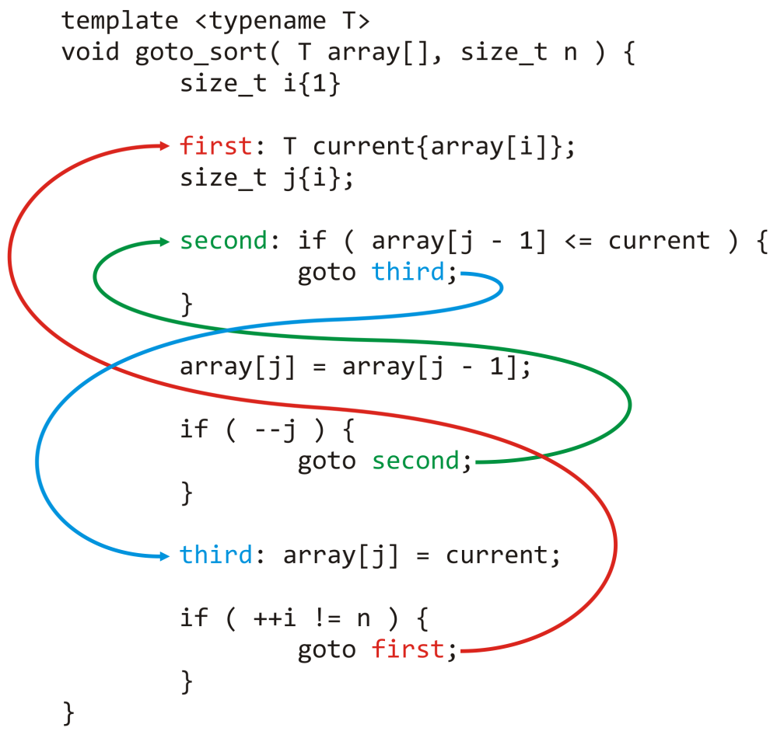
•Normally statements in a program are executed one after the other in the order in which they are written. This process is called sequential execution.
•Using various statements to specify the next statement to change sequential execution is called transfer of control.
• The goto statement is one of these statements. It allows you to break your otherwise single entry – single exit structure of your statements. During the 1960s, it became clear that the random use of transfers of control was the root of much difficulty.
Notes:
Normally statements are executed sequentially because statements are kept sequentially in memory and processor's program counter counts up sequentially.

Slide 3
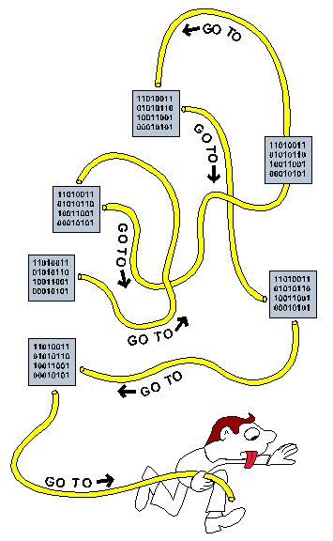
•The research of Bohm and Jacopini had demonstrated that programs could be written without any goto statements. The challenge of the era for programmers was to shift their styles to “goto-less programming.” The term structured programming became almost synonymous with “goto elimination.”
Not until the 1970s did most programmers start taking structured programming seriously. People reported shorter development times, more frequent on-time delivery and within-budget completion.
The key to these successes was that structured programs were clearer, easier to debug and modify, and more likely to be bug free in the first place.
Notes:
Bohm and Jacopini are Italian computer scientists who wrote the famous 1966 paper on structured programming.

Slide 4

•Bohm and Jacopini’s work demonstrated that all programs could be written in terms of only three control structures; the sequence structure, the selection structure and the repetition structure.
•The sequence structure is built into Java and other modern programming languages. Java lets you have as many actions as you want in a sequence structure.
Anywhere a single action may be placed, we may place several actions in sequence.
Notes:
The term Control structures comes from the field of computer science. The Java Language Specification refers to “control structures” as “control statements”.

Slide 5
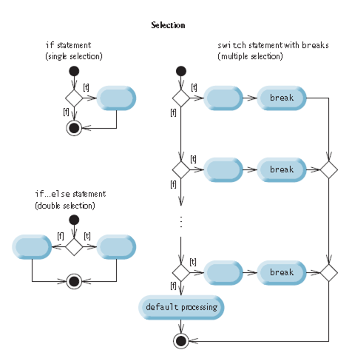
•Selection Statements: Java has three types of selection statements.
The if statement either performs an action if a condition is true, or skips it if the condition is false. It is a single-selection statement because it selects or ignores a single action (or group of actions).
The if…else statement performs an action if a condition is true and performs a different action if the condition is false. It is a double-selection statement. Conditional operator (?:) is a different way of using the if else statement.
The switch statement performs one of many different actions, depending on the value of an expression. It is a multiple-selection statement.
In fact, it’s straightforward to prove that the simple if
statement is sufficient to provide any form of selection—everything that can be done with the if else statement
and the switch statement can be implemented by
combining if statements (although perhaps not as clearly
and efficiently).
Notes:
We can replace an if else statement using two if statements. And we can replace a switch statement using multiple if statements. But they would be inefficient.
If else and switch statements require less calculations to do the same work.

Slide 6
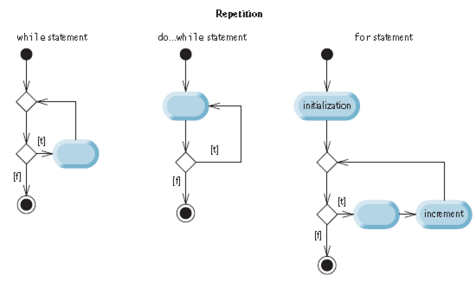
•Repetition Statements: Java provides three repetition statements.
The while and for statements perform the action (or group of actions) in their bodies zero or more times (enhanced
for is a different way of using the for
statement)
The do…while statement performs the
action (or group of actions) in its body one or more times.
It’s straightforward to prove that the while statement is sufficient to provide any form of repetition. Everything that can be done with do…while and for can be done with the
while statement (although perhaps not as conveniently).
Notes:
We can replace a do while statement with a while statement by nesting the do while statement inside an if statement to do the initial check.
For and while statements can do the same work and can be replaces with each other as we will see next.

Slide 7

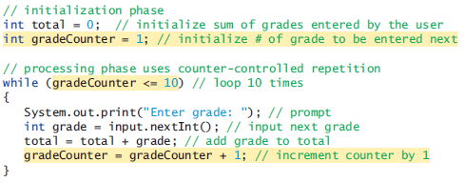
•Counter controlled repetition: We have a counter to control the number of times a set of statements will execute. Counter controlled repetition is often called definite repetition because the number of repetition is known before the loop begins executing.
Four elements of counter controlled repetition are control variable, initial value, loop continuation condition, increment.

Slide 8
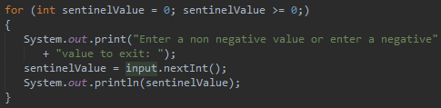
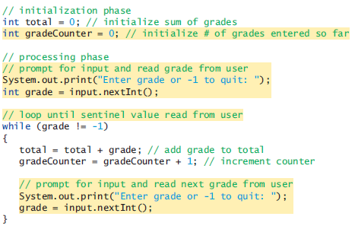
•Sentinel controlled repetition: In definite repetition we knew how many times the loop was going to execute. In indefinite repetition we dont know how many times the loop is going to execute. The loop is going to execute until sentinel value is entered.
Indefinite repetition uses a special value called a sentinel value to indicate “end of data entry.”
While and for statements can be used for sentinel and
counter controlled repetition. But while is generally
used for sentinel controlled and for is generally used forcounter controlled repetition.
Notes:
For statement is usually used for counter controlled repetition because it has all four elements of counter controlled repetition in its header.
While statement is usually used for sentinel controlled expression because while statement resembles the way we think about sentinel controlled repetition.

Slide 9
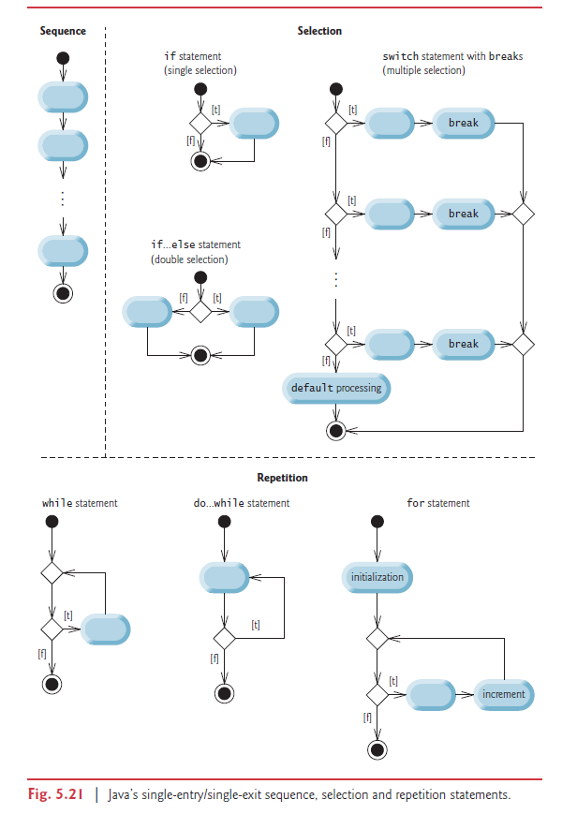
•Structured programming summary: Java has only three kinds of control statements: the sequence statement, selection statements (three types), and repetition statements (three types). Every program is formed by combining as many of these statements as is appropriate for the algorithm the program implements.
For simplicity, Java includes only single-entry/single-exit control statements—there’s only one way to enter and only one way to exit each control statement. This is why goto statement breaks structured programming.
Connecting the exit point of one statement to the entry point of the next is called control statement stacking. When a control statement is inside another, we call that control statement nesting.
Thus, algorithms in Java programs are constructed from only tree kinds of control statements, combined in only two ways. This is the essence of simplicity.
Notes:
This is why goto statement breaks structured programming. It allows us to jump into the middle of selection statements, repetition statement and methods. It also allows us to leave selection statements, repetition statements and methods from multiple location.

Slide 10
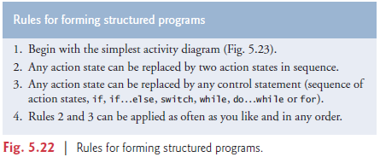
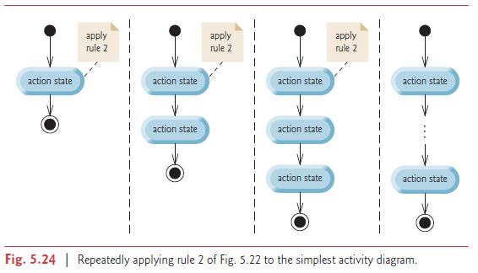
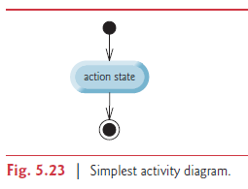
Applying the rules always results in a properly structured activity diagram with a neat, building-block appearance. For example, repeatedly applying rule 2 to the simplest activity diagram results in an activity diagram containing many action states in sequence. Rule 2 generates a stack of control statements, so we can call it the stacking rule.

Slide 11
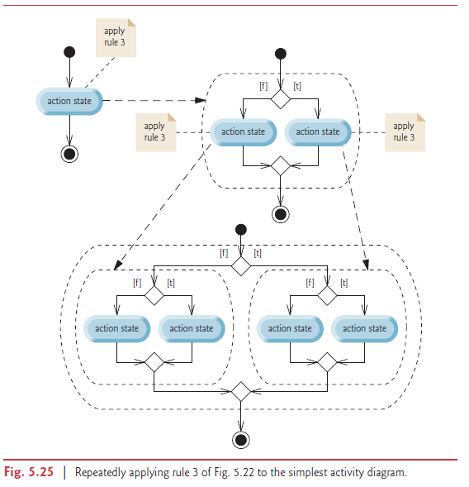
Rule 3 is called the nesting rule. Repeatedly applying rule 3 to the simplest activity diagram
results in one with neatly nested control statements. For example, in Fig. 5.25, the action state in the simplest activity diagram is replaced with a double-selection (if…else) statement. Then rule 3 is applied again to the action states in the double-selection statement, replacing each with a double-selection statement.

Slide 12
Rule 4 generates larger, more involved and more deeply nested statements. The diagrams that emerge from applying the rules constitute the set of all possible structured activity diagrams and hence the set of all possible structured programs. The beauty of the structured approach is that we use only seven simple single-entry/single-exit control statements and assemble them in only two simple ways.

Slide 13
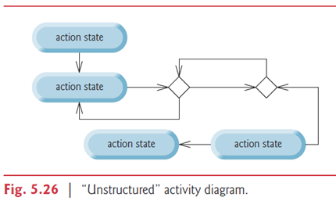
If the rules are followed, an “unstructured’ activity diagram (like the one in Fig. 5.26) cannot be created. If you’re uncertain about whether a particular diagram is structured, apply the rules in reverse to reduce it to the simplest activity diagram. If you can reduce it, the original diagram is structured; otherwise, it’s not. ​
First thing wrong with this program is that the arrow coming out of second decision symbol goes in the middle of the do while statement. It should go to the beginning if we want two nested do while statements. Going to the middle of a do while statement directly can only be achieved with a goto statement.
Second thing wrong with this program is, there is no way of reaching the second part of the program. There is not even a goto statement that jumps to the second part.
Last wrong thing is the fact that there are two out outgoing transition arrows from an action state.

Slide 14
•break: The break statement causes immediate exit from repetition statements or switch statement.
for (count = 1; count <= 10; count++) { // Loop 10 times.
if (count == 5)
break;
System.out.printf("%d ", count);
}
Some programmers feel that break and continue violate structured programming Since the same effects are achievable with structured programming techniques, these programmers do not use break or continue..
for (count = 1; count <= 10 && count != 5; count++)
System.out.printf("%d ", count);

Slide 15
•continue: The continue statement skips the remaining statements in the loop body and proceeds with the next iteration of the loop.
In while and do…while statements, the program evaluates the loop-continuation test immediately after the continue statement executes.
In a for statement, the increment expression executes, then the program evaluates the loop-continuation test.
for (int count = 1; count <= 10; count++) { // loop 10 times
if (count == 5)
continue; System.out.printf("%d ", count); }
To avoid using continue you can use if, if else statements to avoid executing code for a condition.
for (int count = 1; count <= 10; count++) {
if (count != 5)
System.out.printf("%d ", count);
}

Slide 16
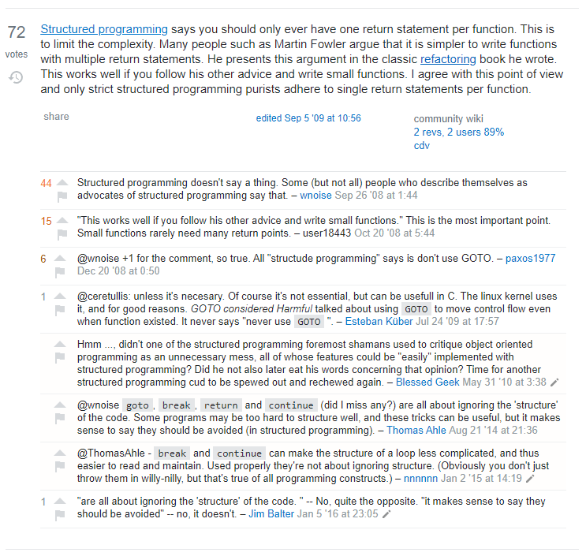
•method call: Method call is fine for structured programming. Because it takes us to the beginning of a method.
•return: Like break and continue statements, structured programming purists don’t like having multiple return statements in their methods.
Programs with multiple return statements can be converted to structured programs by assigning the value to a variable and returning it at the end of the method.
Using break, continue, and multiple return statements tend to make our program more readable and easier to understand.

Slide 17

Sources:
Deitel, P., & Deitel H. (2015).
Java How to Program (10th edition). Pearson.
Stack Overflow (2009). Should a function have only one return statement?.
https://stackoverflow.com/questions/36707/should-a-function-have-only-one-return-statement

